Slide 1
ARRAY SORT MERGE SORT
ALGORITHMS

Slide 2
ARRAY SORT
ARRAY: [ 5 1 21 33 41 59 65 98 69] PIVOT = 69 LEFT (smaller)= 5, 1, 21, 33, 41,59, 65 RIGHT (bigger)= = 98, So we have : [5, 1, 21, 33, 41,59, !65 ! 69 98,] PIVOT = 98 LEFT=[ 5, 1, 21, 33, 41,59, 65] RIGHT = [] So we have : [5, 1, 21, 33, 41,59, !65 ! 69 98,] PIVOT =65 LEFT= =[ 5, 1, 21, 33, 41,59, ] RIGHT = []

Slide 3
ARRAY SORT
PIVOT = 59 LEFT= =[ 5, 1, 21, 33, 41,] RIGHT = [] PIVOT = 41 LEFT= = [5, 1, 21, 33, ] RIGHT = [] PIVOT = 33 LEFT= =[ 5, 1, 21, ] RIGHT = [] PIVOT = 21 LEFT= = [5, 1, ] RIGHT = [] PIVOT = 1 LEFT= =[ 5, ] RIGHT = []

Slide 4
ARRAY SORT
Combine Results Now we combine bottom‑up: [1, 5] | 21 → [1, 5, 21] [1, 5, 21] | 33 → [1, 5, 21, 33] [1, 5, 21, 33] | 41 → [1, 5, 21, 33, 41] [1, 5, 21, 33, 41] | 59 → [1, 5, 21, 33, 41, 59] [1, 5, 21, 33, 41, 59] | 65 → [1, 5, 21, 33, 41, 59, 65] [1, 5, 21, 33, 41, 59, 65] | 69 | [98] → Final Sorted Array = [1, 5, 21, 33, 41, 59, 65, 69, 98]

Slide 5
MERGE SORT
🧮 Step‑by‑Step Merge Sort
Step 1: Split the Array
Divide into halves until each subarray has 1 element:
[5, 1, 21, 33] and [41, 59, 65, 98, 69]
[5, 1] and [21, 33]
[41, 59] and [65, 98, 69]
[65] and [98, 69] → [98] and [69]

Slide 6
Step‑by‑Step Merge Sort
🧮 Step‑by‑Step Merge Sort
Step 1: Split the Array
Divide into halves until each subarray has 1 element:
[5, 1, 21, 33] and [41, 59, 65, 98, 69]
[5, 1] and [21, 33]
[41, 59] and [65, 98, 69]
[65] and [98, 69] → [98] and [69]
C

Slide 7
Step 3: Merge Larger Subarrays
Step 3: Merge Larger Subarrays
[1, 5] + [21, 33] → [1, 5, 21, 33]
[41, 59] + [69, 98] → [41, 59, 69, 98]
[65] + [41, 59, 69, 98] → [41, 59, 65, 69, 98]
Step 4: Final Merge
[1, 5, 21, 33] + [41, 59, 65, 69, 98] → Final Sorted Array = [1, 5, 21, 33, 41, 59, 65, 69, 98]

Slide 8
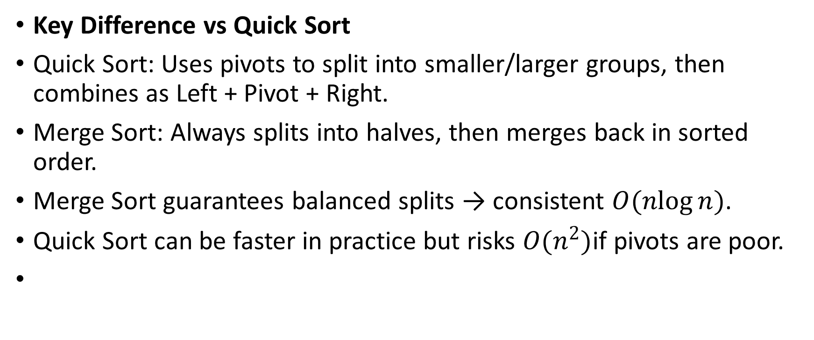
Key Difference vs Quick Sort
Key Difference vs Quick Sort
Quick Sort: Uses pivots to split into smaller/larger groups, then combines as Left + Pivot + Right.
Merge Sort: Always splits into halves, then merges back in sorted order.
Merge Sort guarantees balanced splits → consistent $O(nlog⁡n)$.
Quick Sort can be faster in practice but risks $O(n^{2})$if pivots are poor.

